Slide 1
Today
Lecture 23: Decoherence and the Transmon qubit
Discussion of applications of superconductor materials and devices in five parts:
Overview of the quantum information landscape
Macroscopic quantum phenomena in superconductor devices and superconductor qubits
Decoherence and the emergence of the transmon qubit
Topological superconducting qubits based on Majorana fermion states
S-TI-S Josephson junctions --- a compelling platform
Next time
Lecture 24: Topological qubits and Majorana fermions

Slide 2
Final project
6 groups + individual papers
Explore a topic --- make a set of slides
12 minute presentation on Tuesday, May 10 (last day of class)
Topics:
Conventional SC qubits vs. topological SC qubits
SC qubits vs. ion trap qubits
SC qubits vs. semiconductor qubits
Quantum Supremacy
Superconductors for Quantum Sensing
Quantum computing for discovery of new superconductors
Very unstructured open-ended assignment
Will need to explore the internet to find interesting materials and converge on a theme and focus for your presentation
Emphasis is on learning something and sharing that with all of us --- to me, this assignment will be successful if we all learn some new things and come away with a picture of the potential and challenges of superconductivity in quantum information science and technology
Goal is for everyone to participate --- I would suggest that your team make a plan and have each person contribute some specific component or specific slides to the presentation

Slide 3
Conventional SC qubits vs. topological SC qubits | SC qubits vs. ion trap qubits | SC qubits vs. quantum dot or semiconductor qubits
Abboud, Nick | Birchmier, Rachel Lucille | Fu, Wenning
Beach, Alexander R | Rooke, Spencer George | Ganesan, Vishal
Song, Xiangyu | Wild, Drew Glenn | Peng, Yu-Ting
Suresh Babu, Soorya | Wu, Junyi | Wu, Dufei
Quantum Supremacy | Superconductors for Quantum Sensing | Quantum computing for the discovery of new superconductors/materials
Gabrisko, Nick | Hu, Yuxuan | Apte, Sohm Shailesh
Kim, Dong Beom | Tsai, Pei-Wen | Vaz, Daniel Edward
Montone, Jessica H |  | Zhang, Michael
Wang, Ningdong |  | Zvenigorodsky, Serge
RESEARCH PAPERS
 | Agrawal, Shraddha
 | Baker, Carina Franziska
 | Lennox, Amber Rose Elizabeth
 | Lin, Haoran
 | Ma, Max

Slide 4
Superconductor qubits
Macroscopic Quantum Phenomena --- ways in which SC devices behave as quantum mechanical objects
Types of superconductor qubits
charge qubits
phase qubits
flux qubits
hybrid charge-phase qubits (one example is the transmon qubit)
Decoherence
  Characterization T₁, T₂
  Sources of decoherence
  Reducing decoherence
Verified qubit operation (superposition of quantum states)
How good does it need to be to do “quantum computing”?
Transmon qubit --- developed to avoid decoherence

Slide 5
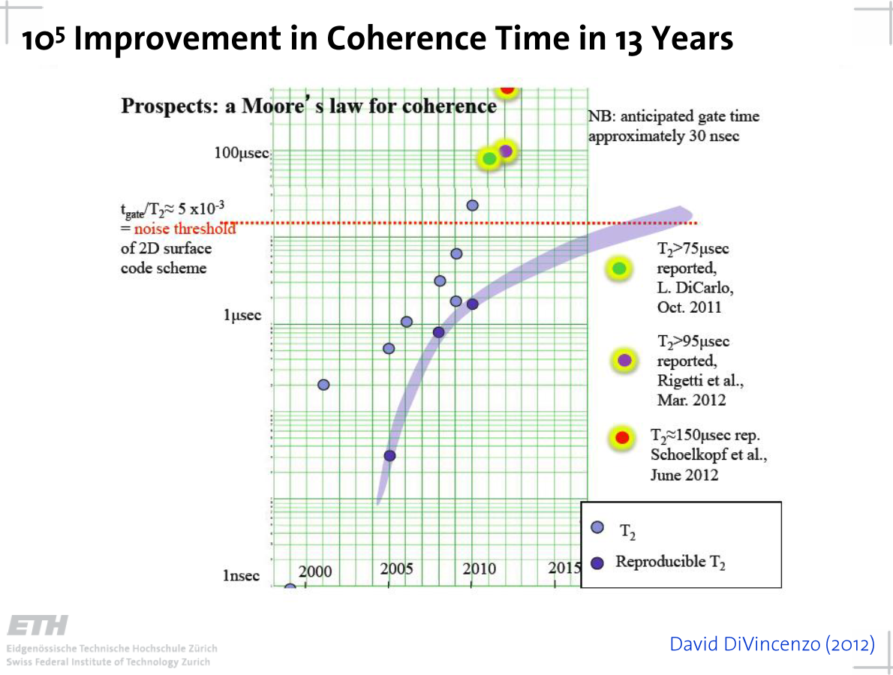

Slide 6
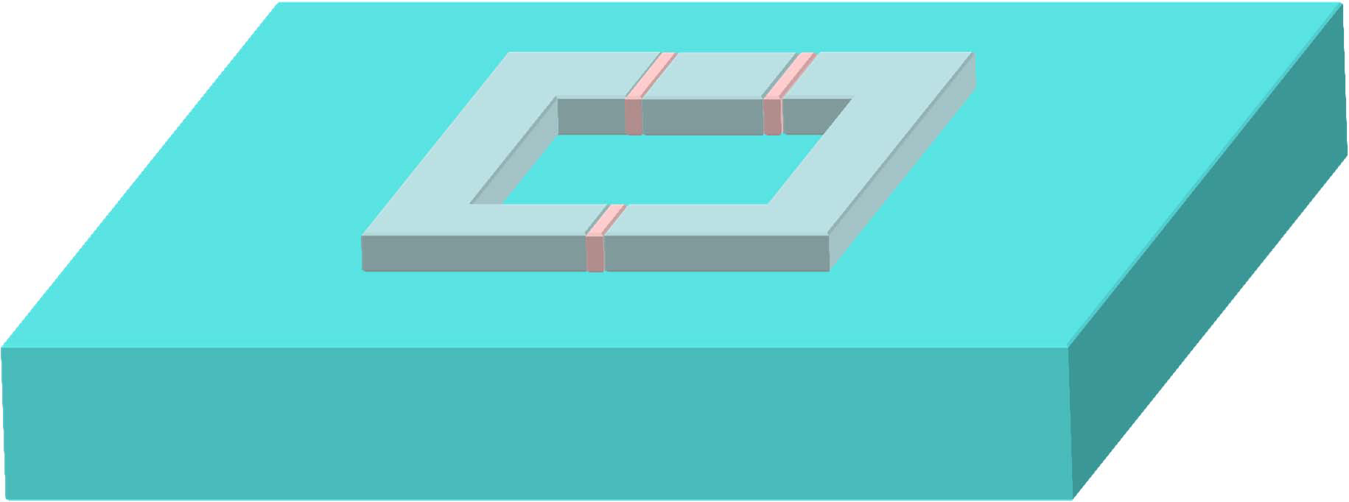
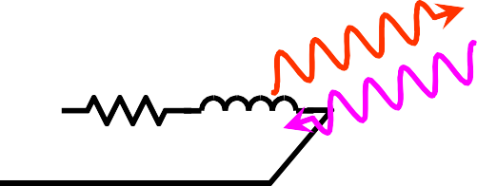

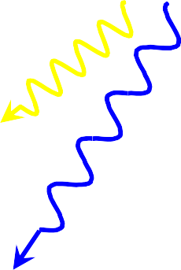
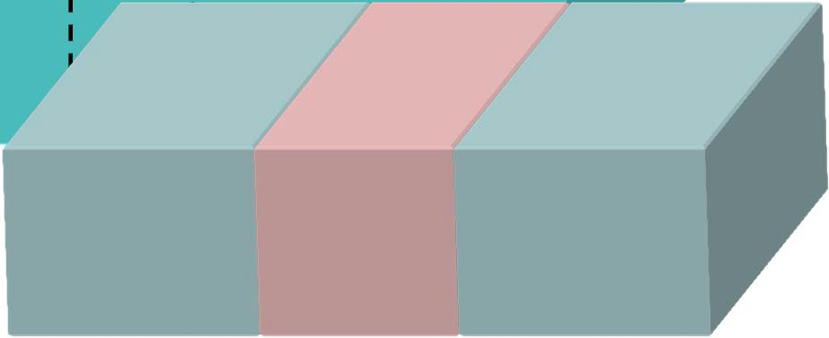


Sources of Decoherence
magnetic-field noise
paramagnetic/nuclear spins
environment circuit modes
charge fluctuations
dielectric losses
phonons
quasiparticle tunneling
photons
critical current fluctuations from charges
Bottom line is that anything and everything matters --- and if does not now, it will at some point as circuits scale in size and complexity

Slide 7
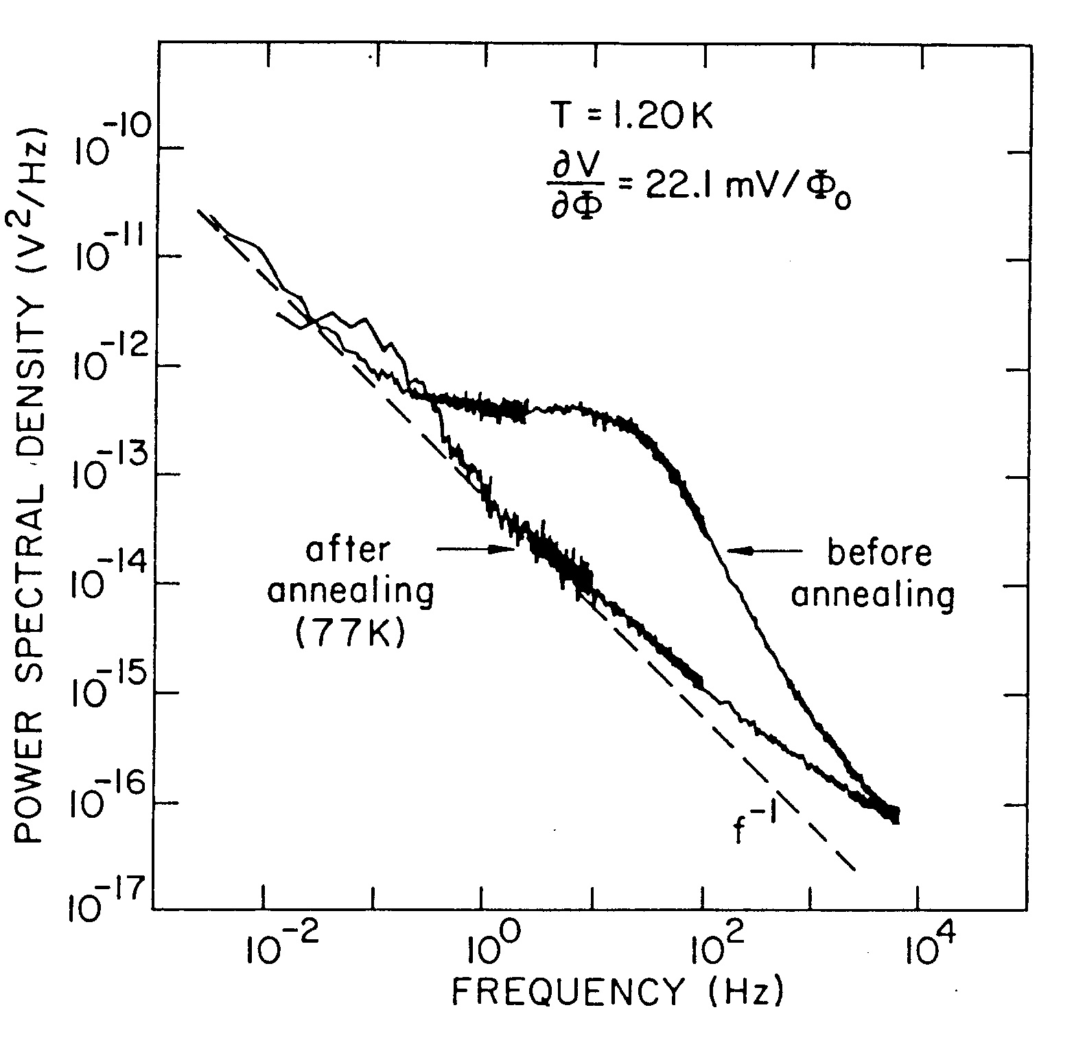
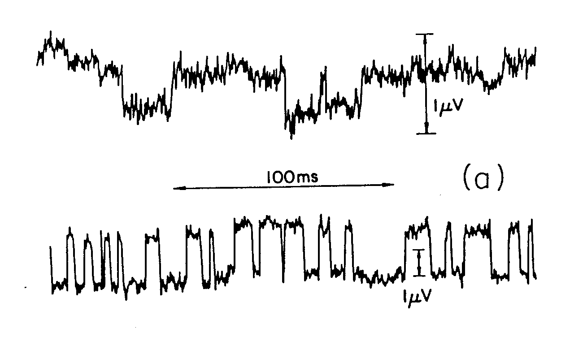
Sources of low frequency noise in superconducting qubits
Flux noise … vortex motion
Critical current noise … charge motion
Magnetic moments and/or vortices hopping in SC film induces flux changes in qubit loops
dominates for large loops
and large junctions
Charge trapping in Josephson junction barrier blocks tunneling in localized region  change in critical current
dominates for small loops
and small junctions
Single vortex/charge trap creates switching noise → Lorentzian in power spectrum
Multiple vortices/charge traps add to give ~1/f noise spectrum (Dutta-Horn model)
Example: charge traps in tunnel junctions
(Wakai, Van Harlingen)

Slide 8
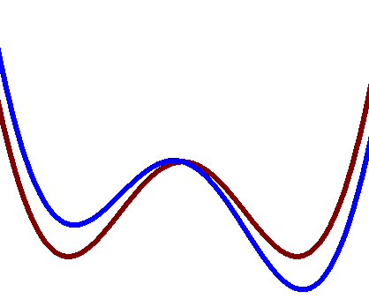
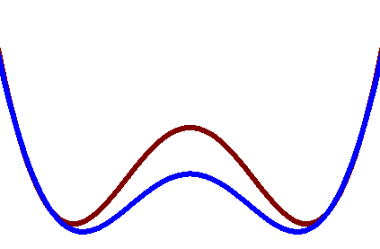
Effect of low frequency noise on the measurement of coherent quantum oscillations
rf SQUID qubit
1/f flux noise in qubit and coil current noise modulates flux bias
from ½ Φ0
1/f critical current noise modulates tunneling barrier height
I
IC
L
δΩ ~ (ΔΦ)²
δΩ ~ ΔIc
ΔIC
ΔΦ
Φ
Fluctuation of the tunneling frequency causes phase noise  results in an effective decoherence since Ω is different for each successive point of a distribution measurement
t
dephasing factor:

Slide 9
Effect of critical current fluctuations on tunneling frequency
Λ = 40.6
Λ = 20.4
Λ = 19.3
Λ = 1.0

Slide 10
Determining the decoherence time from 1/f noise
Assume a measurement of the coherent oscillations in a qubit
τφ
Φave
t
Ω
Put in 1/f critical current noise with spectrum appropriate to the measurement scheme:
τss = single shot flux sampling time (~ 1ms)
Nss = number of flux samples at each time (> 1000)
Np = number of time points to map oscillations (> 100)
N = Nss x Np = total number of measurements (> 10⁵)
N τss = total measurement time (> 100s)
Determine decoherence time τφ limited by dephasing

Slide 11
Numerical simulation
Assume a 1/f critical current noise spectrum:
Generate critical current fluctuation distribution:
Example:
Calculate flux oscillations averaged over the ensemble of measurements:
Ic = 1 μA
Ω/2π = 10 GHz
Λ = 10
τφ ≈ 450ns

Slide 12
General expression: decoherence from 1/f critical current noise
1/f critical current noise:
decoherence time:

Slide 13
Qubit parameters and predicted performance (T=100mK)
~2005
Conclusion: Predicted decoherence times from 1/f noise are longer than what has been obtained by measurements (<< 1μs) but could become a limiting problem in the future (similar study and conclusion for flux noise)

Slide 14
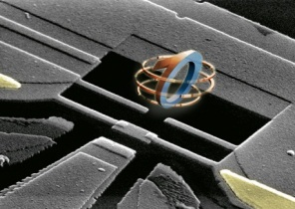
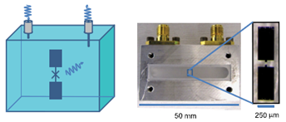
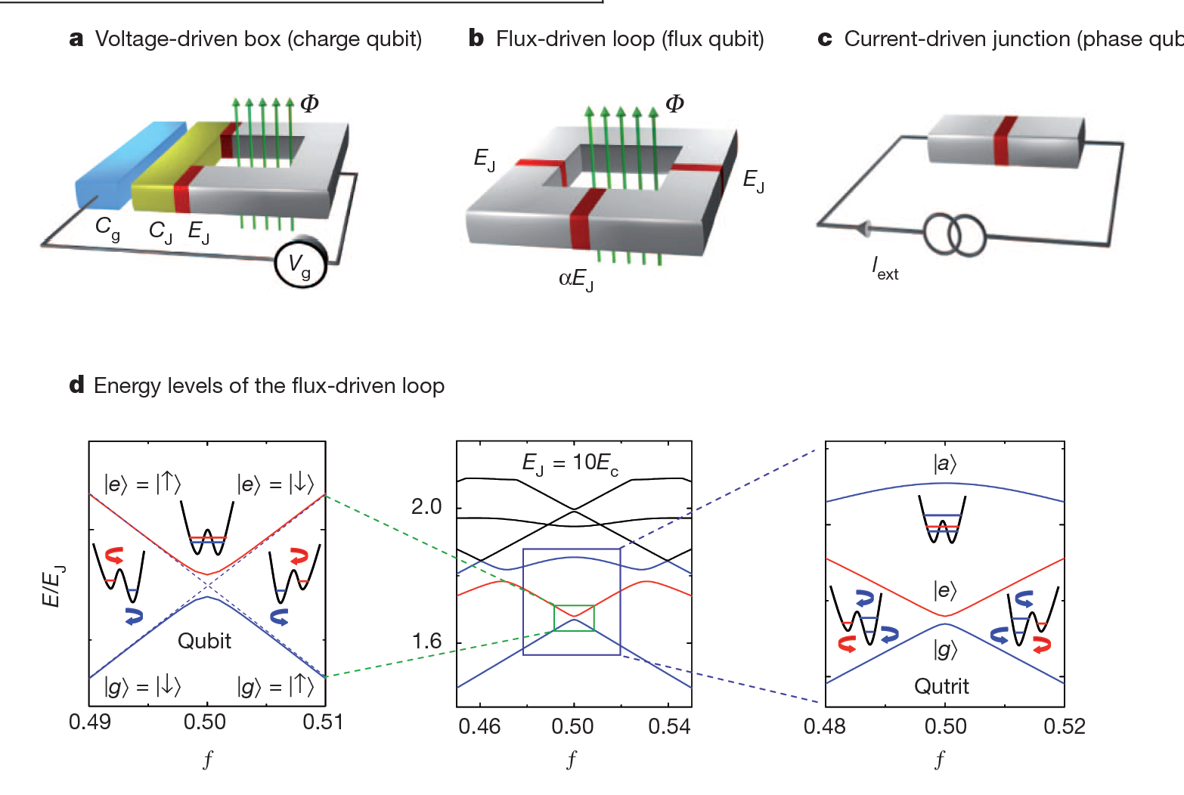
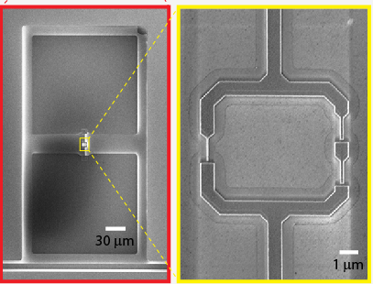
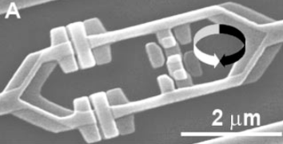
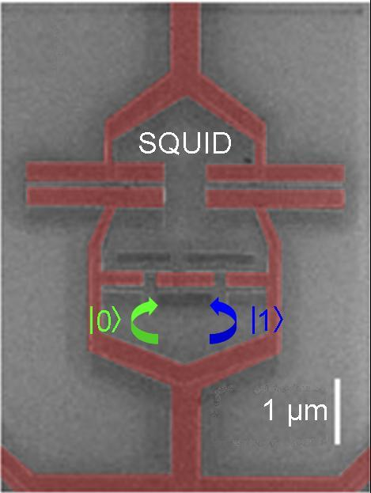
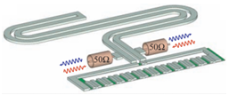
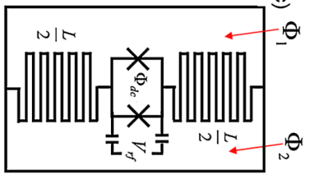
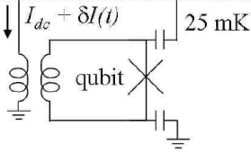
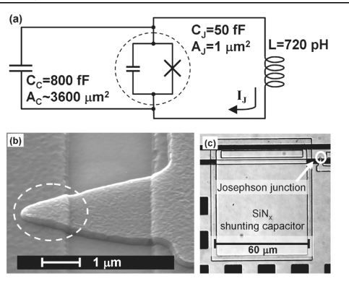
Superconducting Qubits
Taxonomy and Evolution
Double degeneracy CPB
(Quantronium, Saclay)
C-shunt CPB (2D Transmon, Yale, …)
C-shunt CPB in 3D cavity (3D Transmon, Yale)
Charge Qubits
Cooper Pair Box (CPB)
3JJ Persistent-current QB
(Delft, MIT, NEC, NTT)
C-Shunt 3JJ Qubit
(RIKEN, IBM, MIT)
4JJ Qubit
(Delft, IBM)
Flux qubits
L-shunted RF SQUID
(JJ-string inductor, Fluxonium, Yale)
RF SQUID Qubit
(Stony Brook)
Phase qubits
C-shunted, Flux-Biased Phase Qubit
(NIST, UCSB)
L-shunted RF SQUID
(nanowire inductor,
metastable, MIT/LL)
Flux-biased Phase QB
(NIST)

Slide 15
Transmission line + plasmon = “transmon”

Slide 16
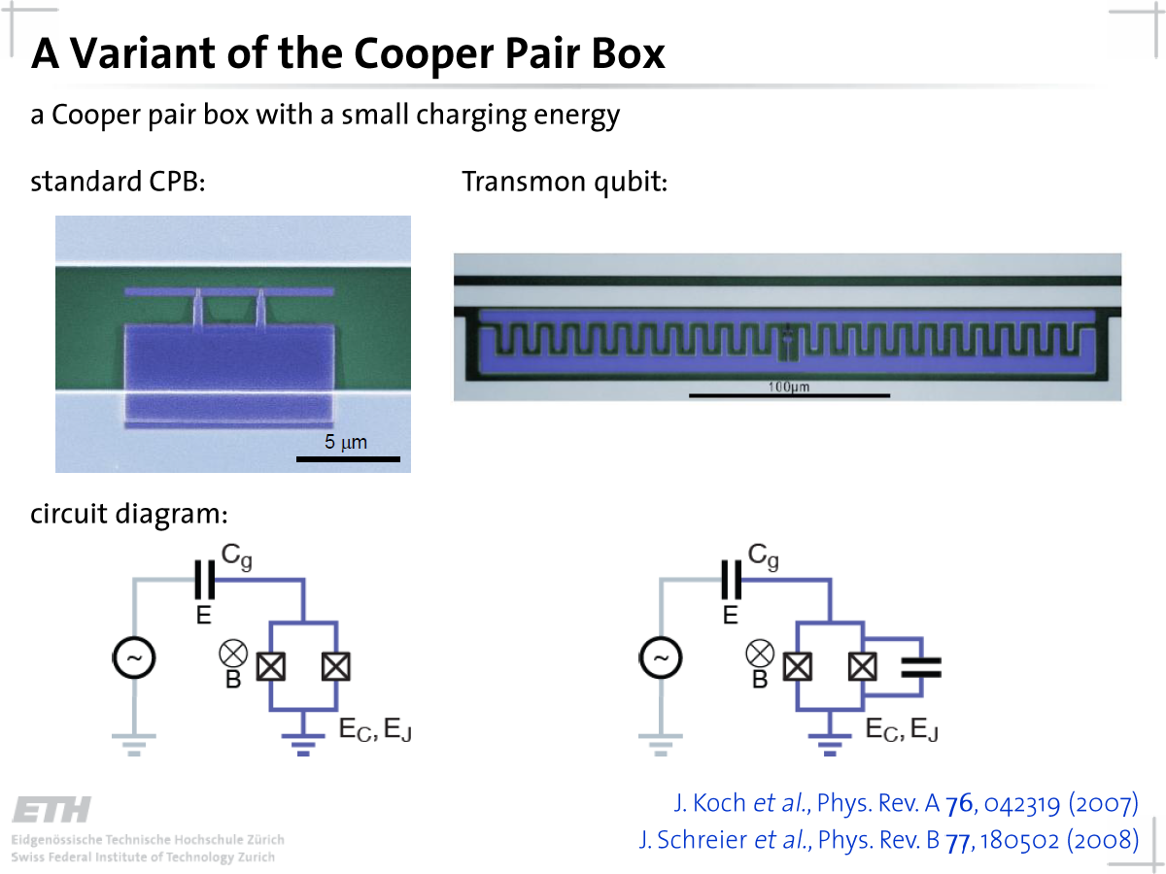

Slide 17
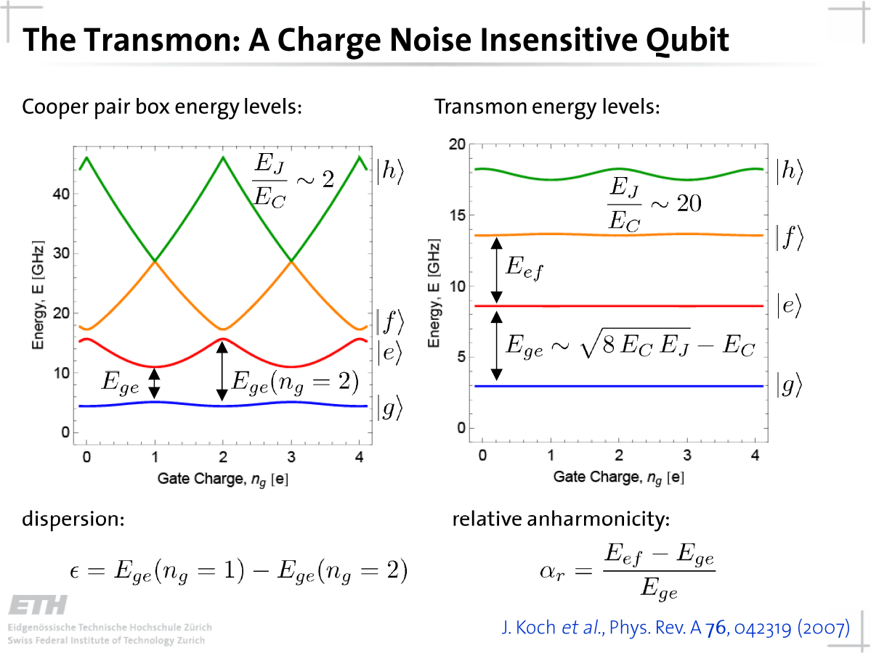

Slide 18
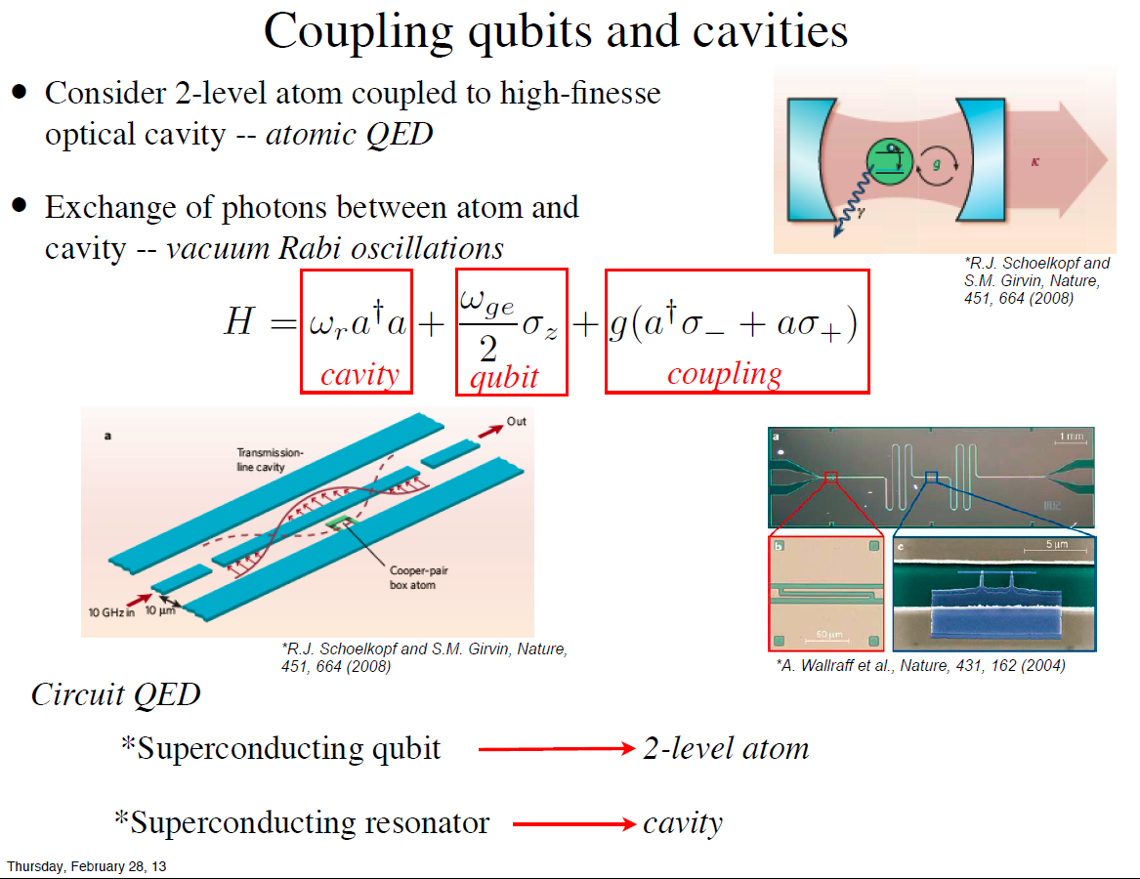

Slide 19
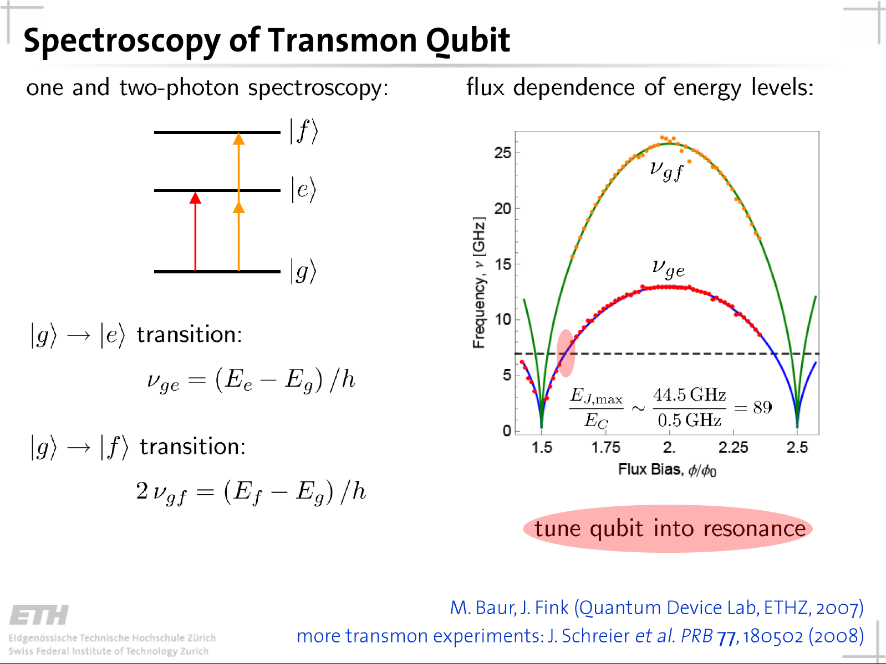

Slide 20
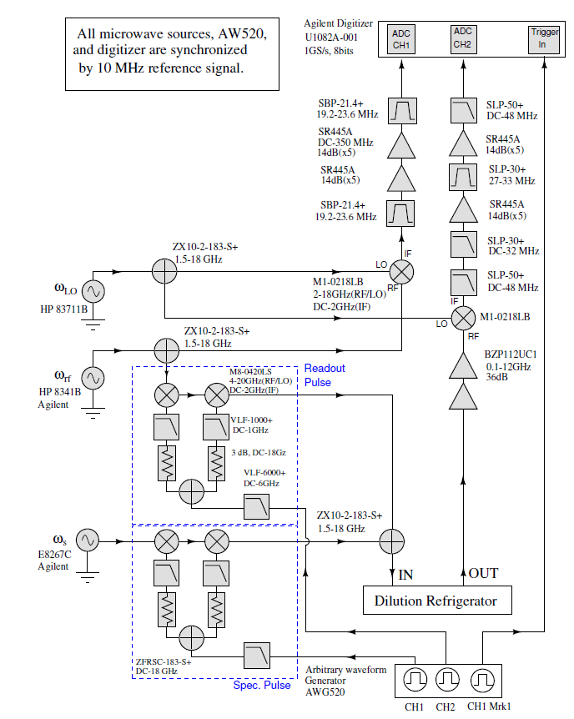
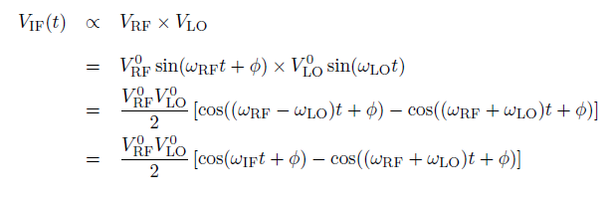
Measure the qubit using microwave
Continuous microwave is controlled by mixer to form microwave pulses
The output signal is mixed with another frequency microwave then filtered to generate measurable signal in MHz range.

Slide 21
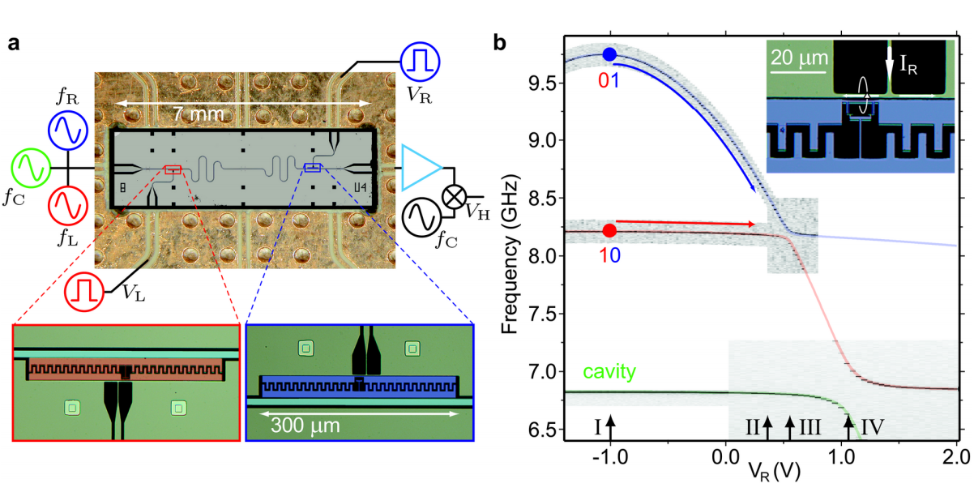
Two transmons coupled via a resonator
Di Carlo et al, Nature 2009

Slide 22
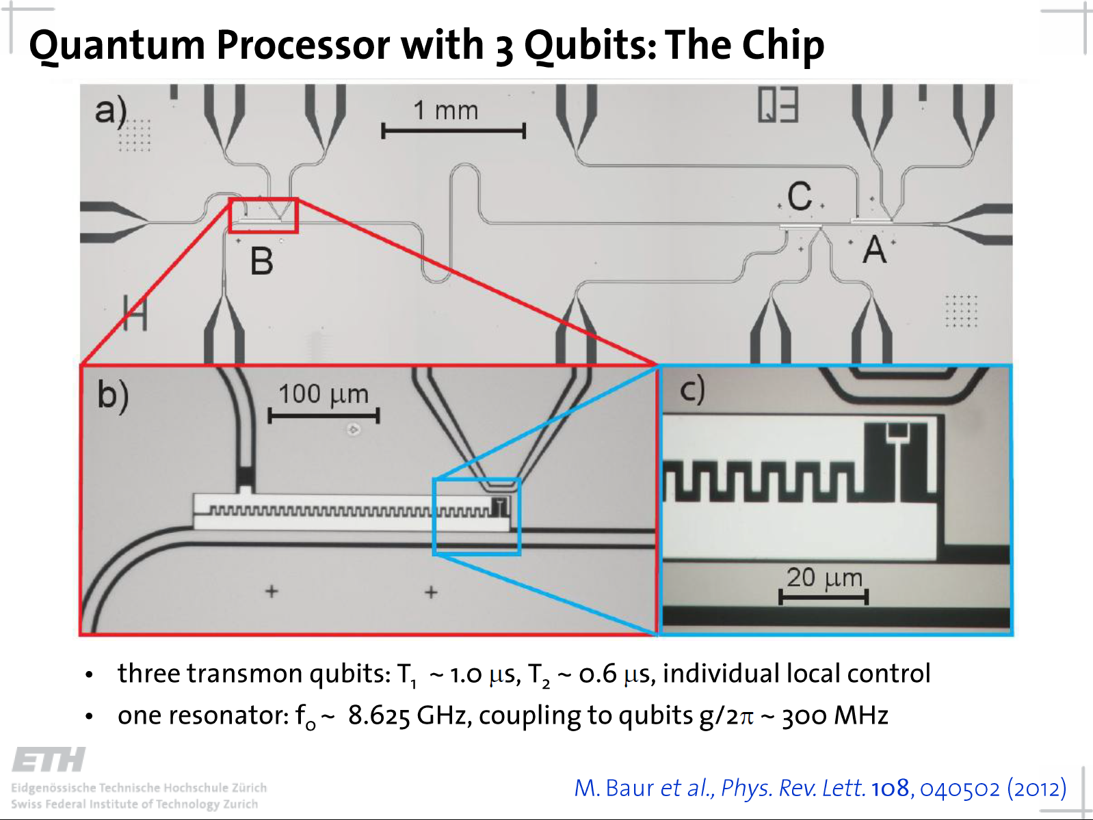

Slide 23
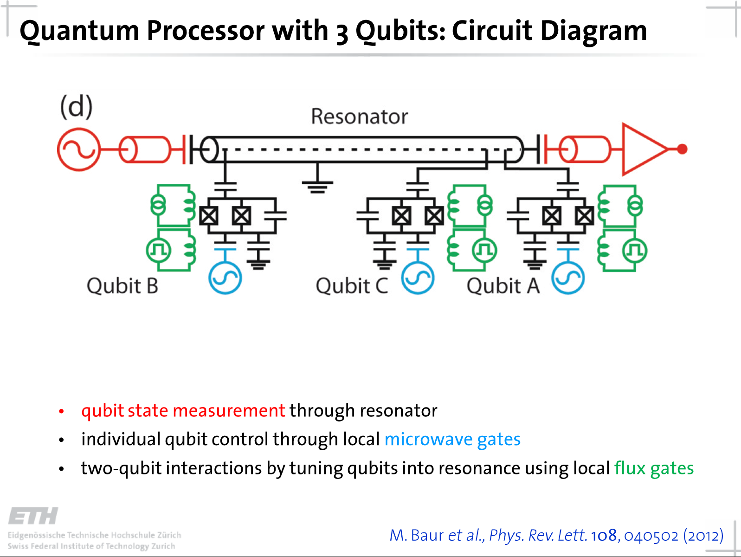

Slide 25
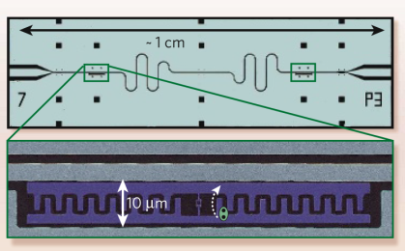
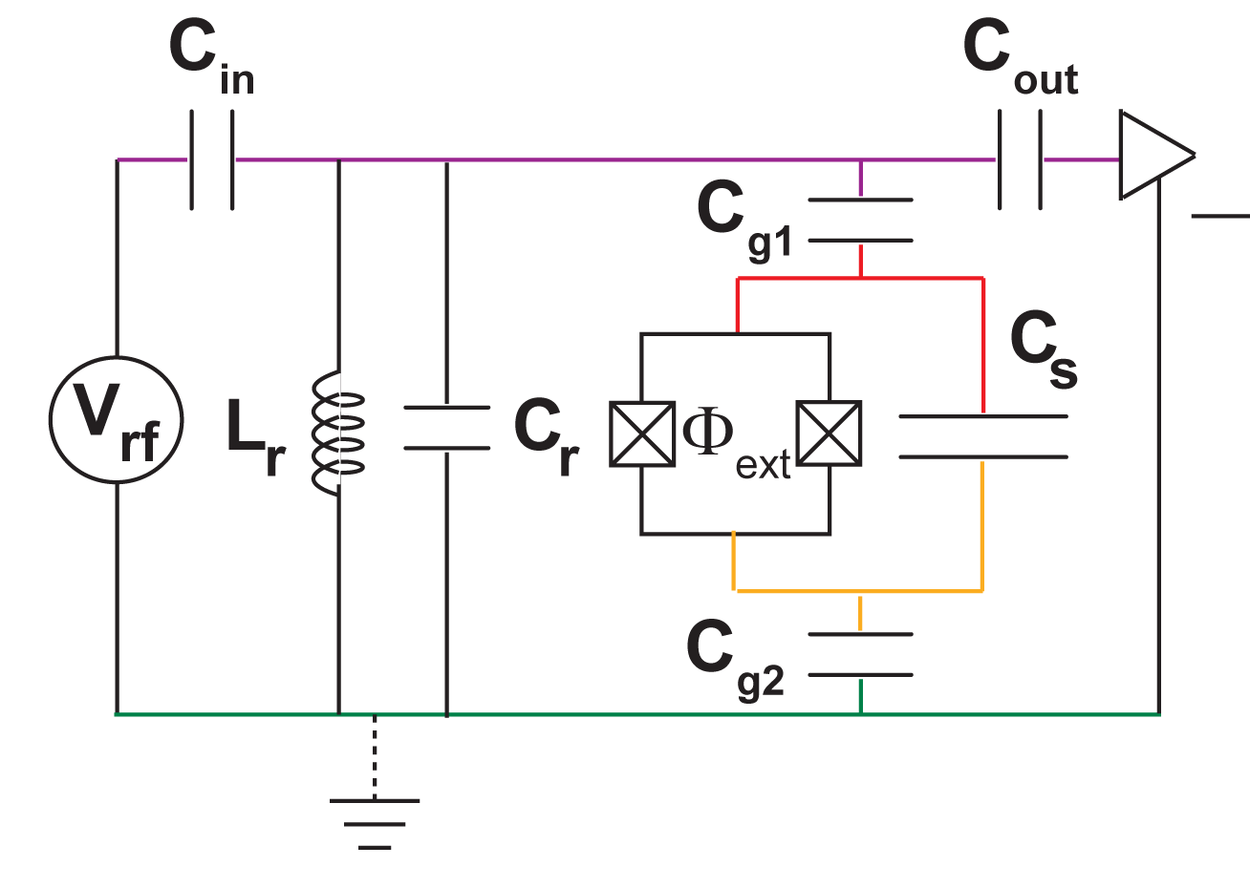
Shunt Capacitor Loss & Participation
How lossy is the shunt capacitor C_{s}?
“2D” Transmon
Planar inter-digitated capacitor (IDC) loss put T₁ ~ 1-10 us.
Today, materials improvements put T₁ ~ 50 us.
C_{S} dominates the capacitance
Most capacitive energy is stored in C_{S}
→ C_{S} has the largest “participation”
Options:
1) improve materials → reduce loss
2) reduce E-field density in lossy region
“3D” Transmon
Electric field
Large plates form capacitance through the large cavity, predominantly vacuum. T₁ in range 10-100 us. The cost is a much larger form factor for the device (cm size)
H. Paik et al., PRL 107, 240501 (2011)

Slide 26
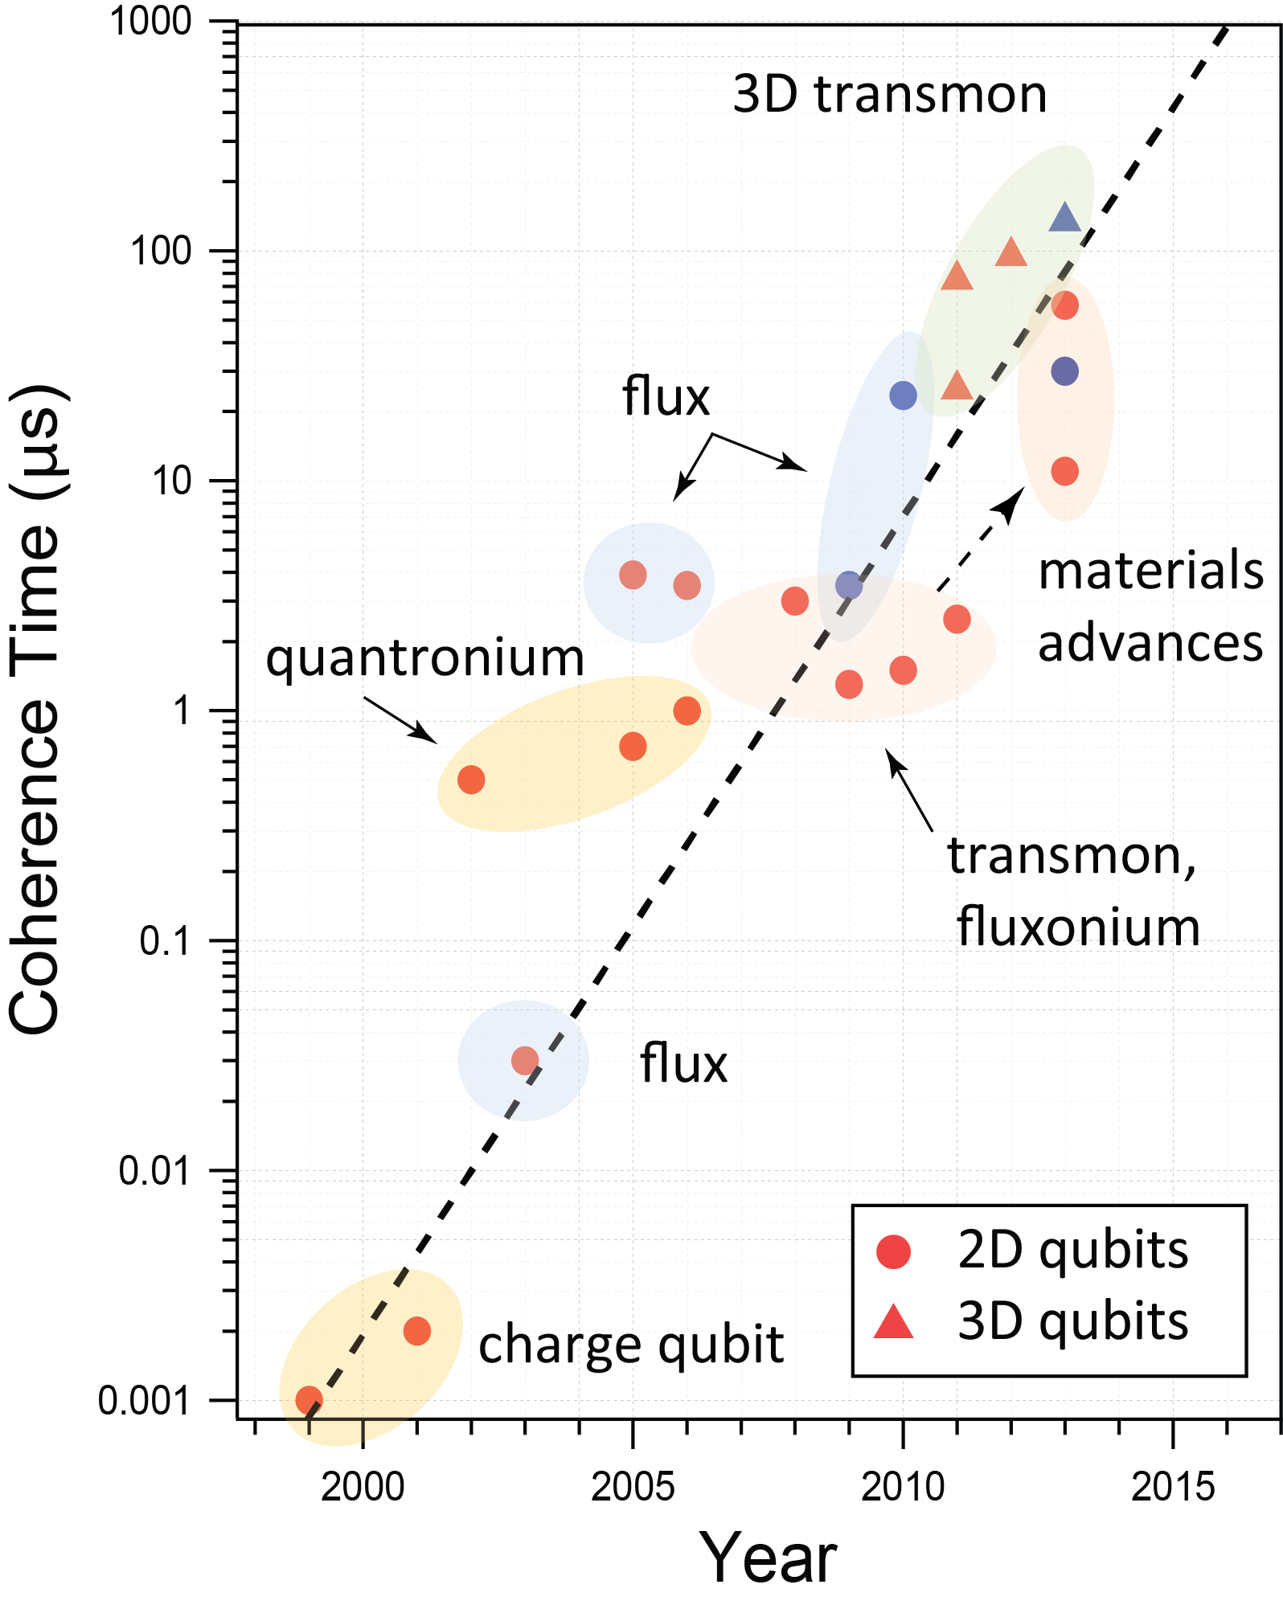
Superconducting Qubits:
Remarkable improvements in qubit coherence
“Moore’s Law” for T₂
Remarkable improvement in T_{1,2} by groups worldwide
  Materials
  Fabrication
  Design
Major qubit types (times at MIT)
  Flux qubit: T₂ = 23 us
  2D transmon: T₂ = 35 us
  3D transmon: T₂ = 150 us
  C-shunt flux qubit: T₂ = 100 us
Applications
  Gate-based quantum computing
  Quantum annealing
several groups 100-150 us
(Delft, IBM, MIT, Yale, …)
lowest thresholds
for quantum
error correction
NIST/IBM, Yale, ...
MIT-LL Nb Trilayer
Blue: MIT & LL
Five orders of magnitude improvement in T₂ over the past 15 years by groups worldwide.
Oliver & Welander, MRS Bulletin (2013)

Slide 28

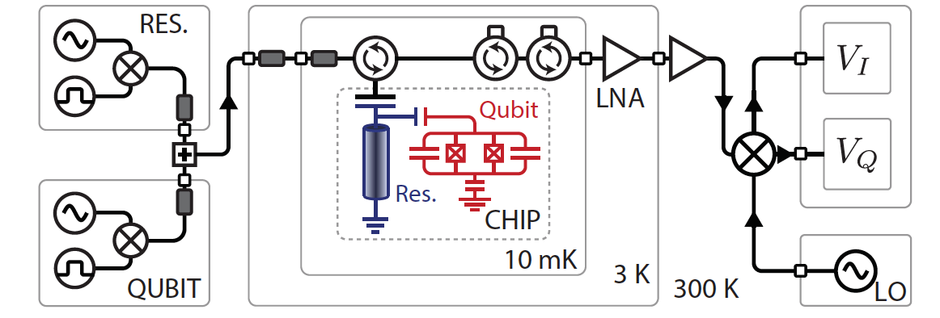
Measurement Chain
Pulse generation
Cryostat input
Physics
Cryostat output
Data acquisition

Slide 29
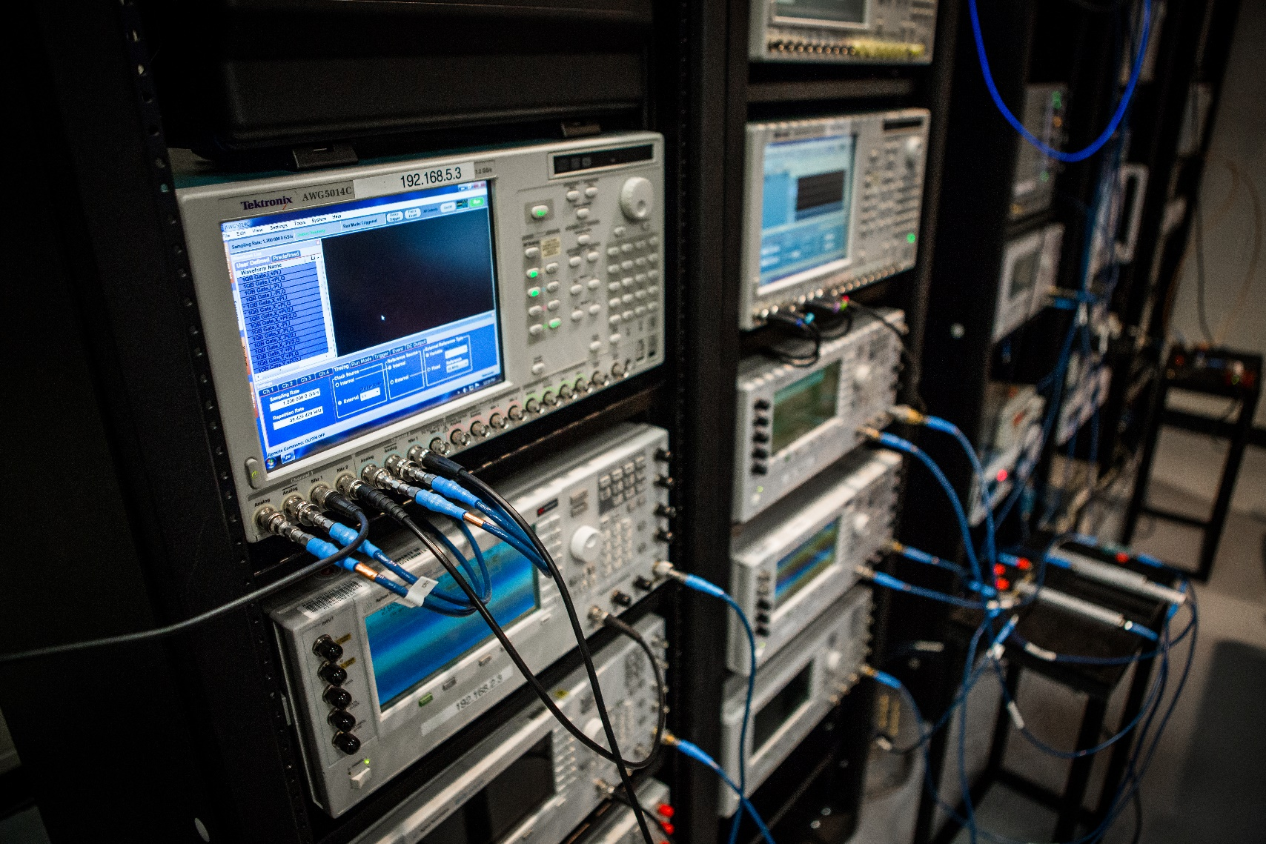
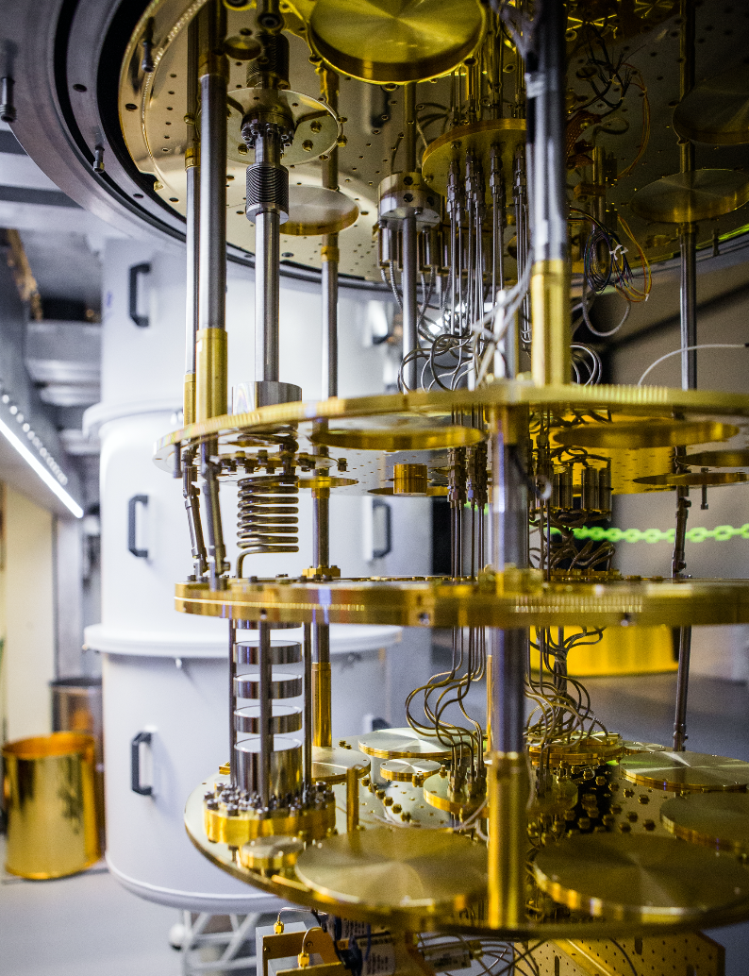
Classical to Quantum to Classical Interfaces

Slide 30

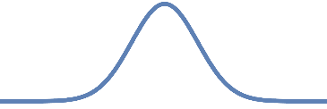
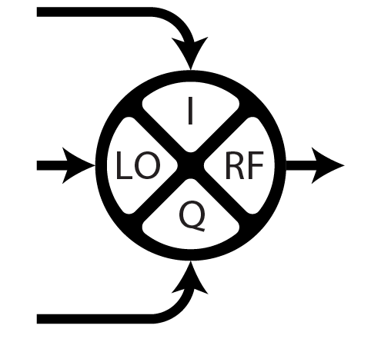
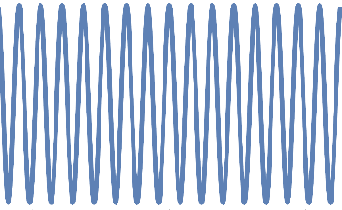
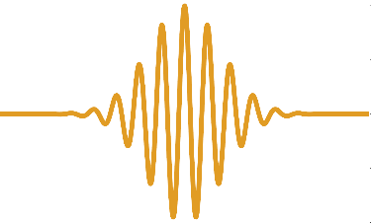


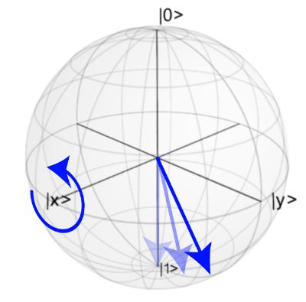
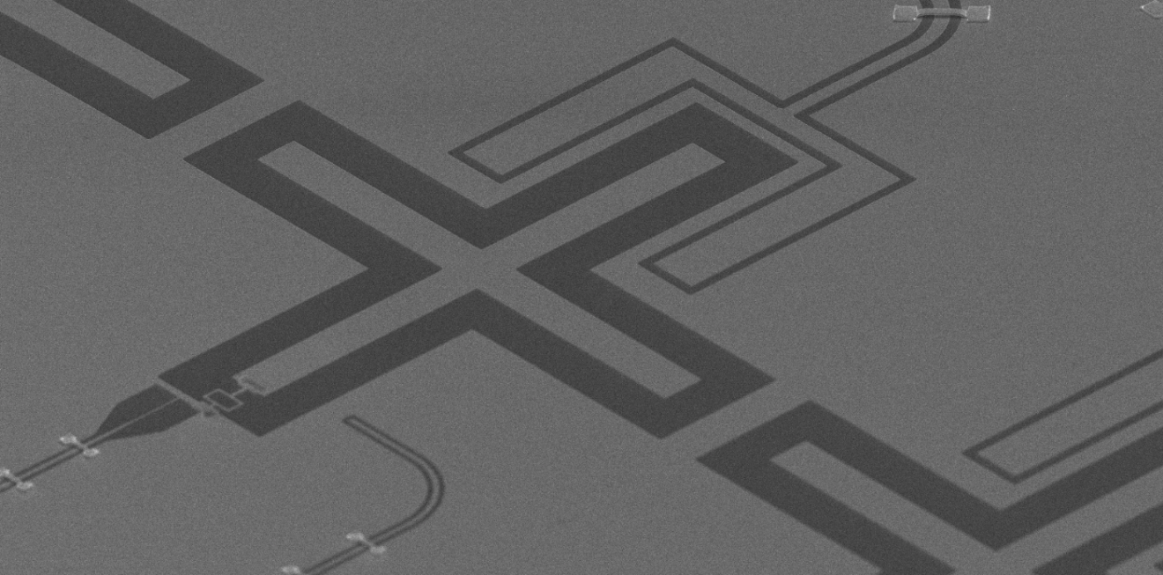
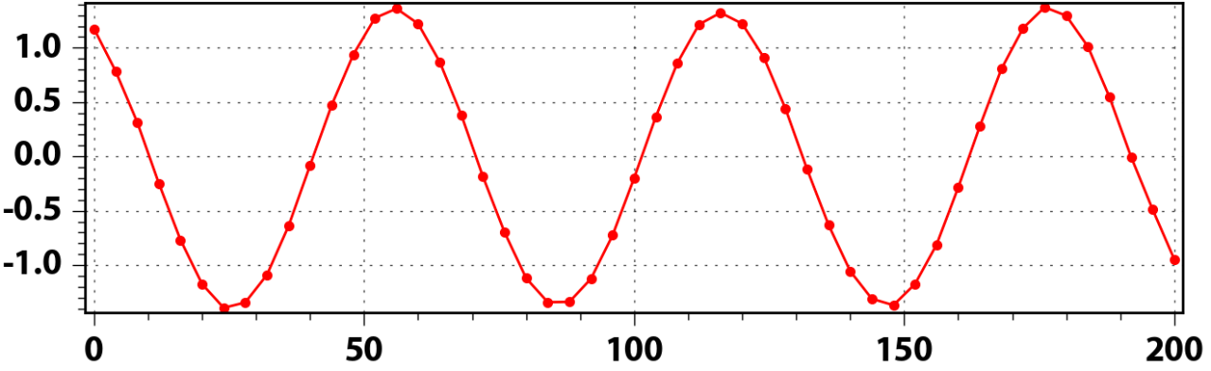
Qubit control - applying qubit drive tones
Statement
In the rotating frame of the qubit, we can show that its drive Hamiltonian can be written
where the pre-factor is the pulse envelope
State pop. [a.u.]
Pulse duration, [ns]

Slide 31
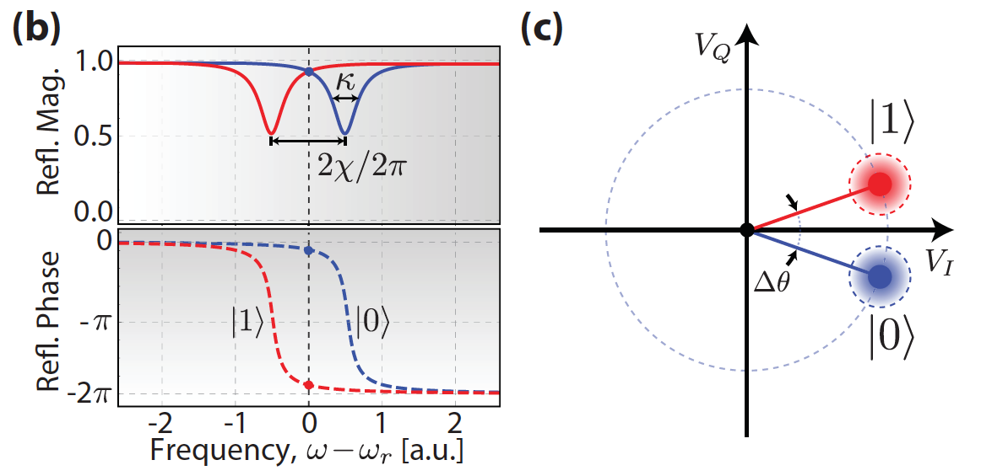















Dispersive readout
Jaynes-Cummings Hamiltonian
Resonator
Qubit
Interaction
Dispersive regime:
Conclusion
All we need to do now is to measure the resonator response to find out the qubit state.
Dispersive frequency shift
Map of quantum properties to microwave response
A. Blais, et al. Phys. Rev. A, 69, 062320, (2004)

Slide 32

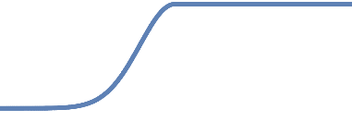
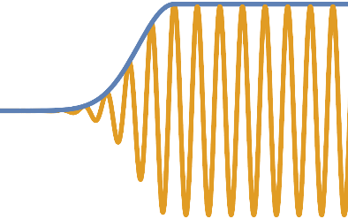
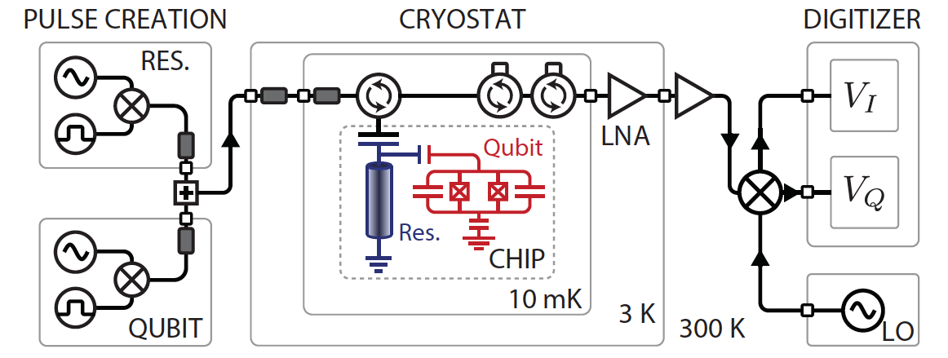
Dispersive readout
Resonator drive tone
To read out the qubit state, we send a readout pulse to the resonator at a fixed frequency
Maximum state discrimination when biased just in between the two S-curves.

Slide 33
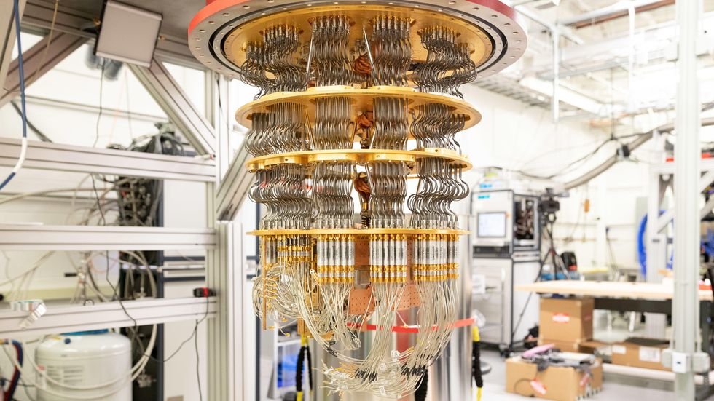
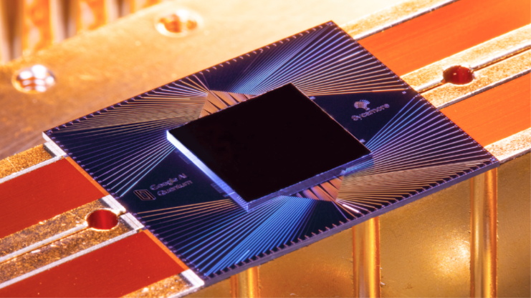
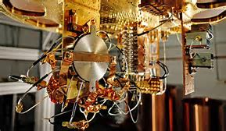
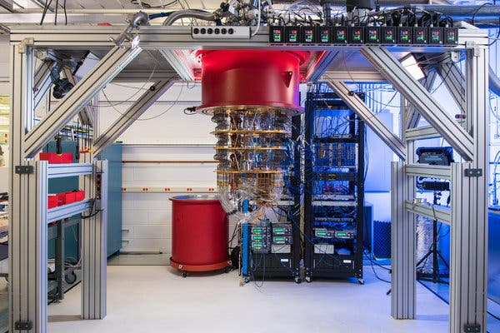
Google

Slide 34
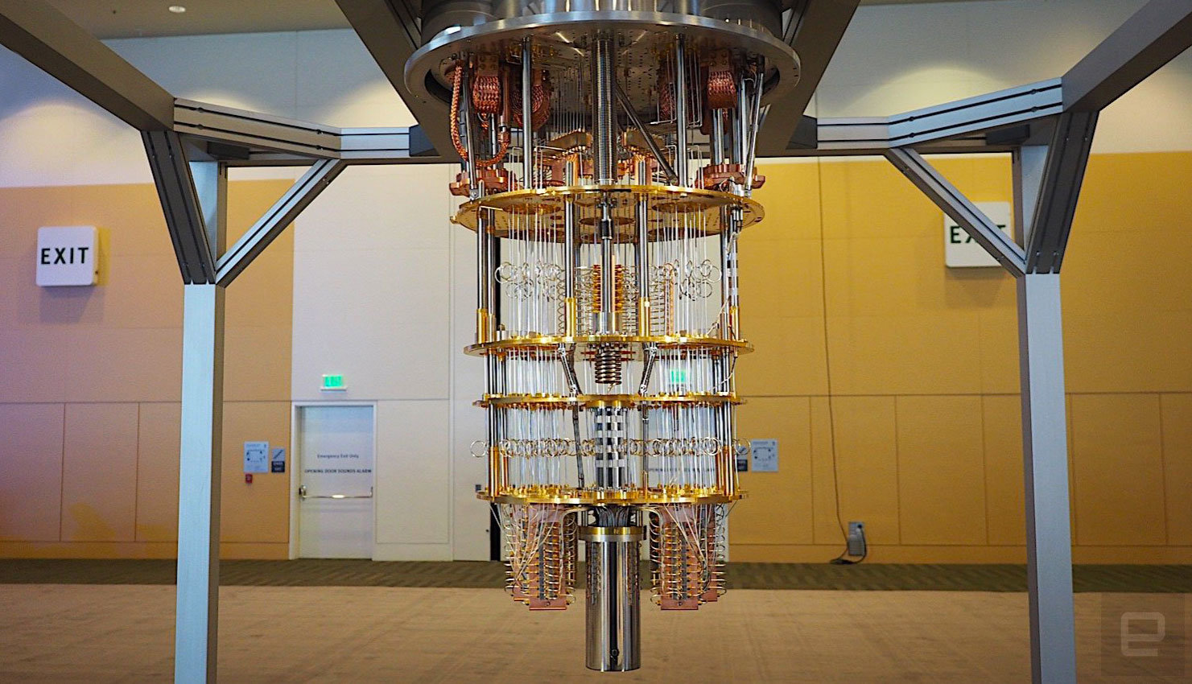



IBM

Slide 35



Slide 36


